Slide 1
SANTA ANA BUILDING HEALTHY COMMUNITIES
Overview
Vision, Mission
Objectives
Participants
Structure
The Work

Slide 2
Vision and Core Values
“In 2020, Central Santa Ana will be a healthy, safe and vital community where diversity is a strength and residents of all ages work together and in partnership with multiple sectors to create opportunities for optimal physical, mental, economic and social well-being across geographic boundaries.”
Four principles values drive the SABHC community and its work:
(1) Family is the heart of community and social change;
(2) Trust and Respect are necessary to build relationships and work together day-today to reach our long term goals;
(3) Mutual accountability, transparency and accountability across affinity groups (systems leaders, residents, organizations) are necessary to make the changes we want;
(4) We embrace diversity; it is a strength and infused in all the work we do.

Slide 3
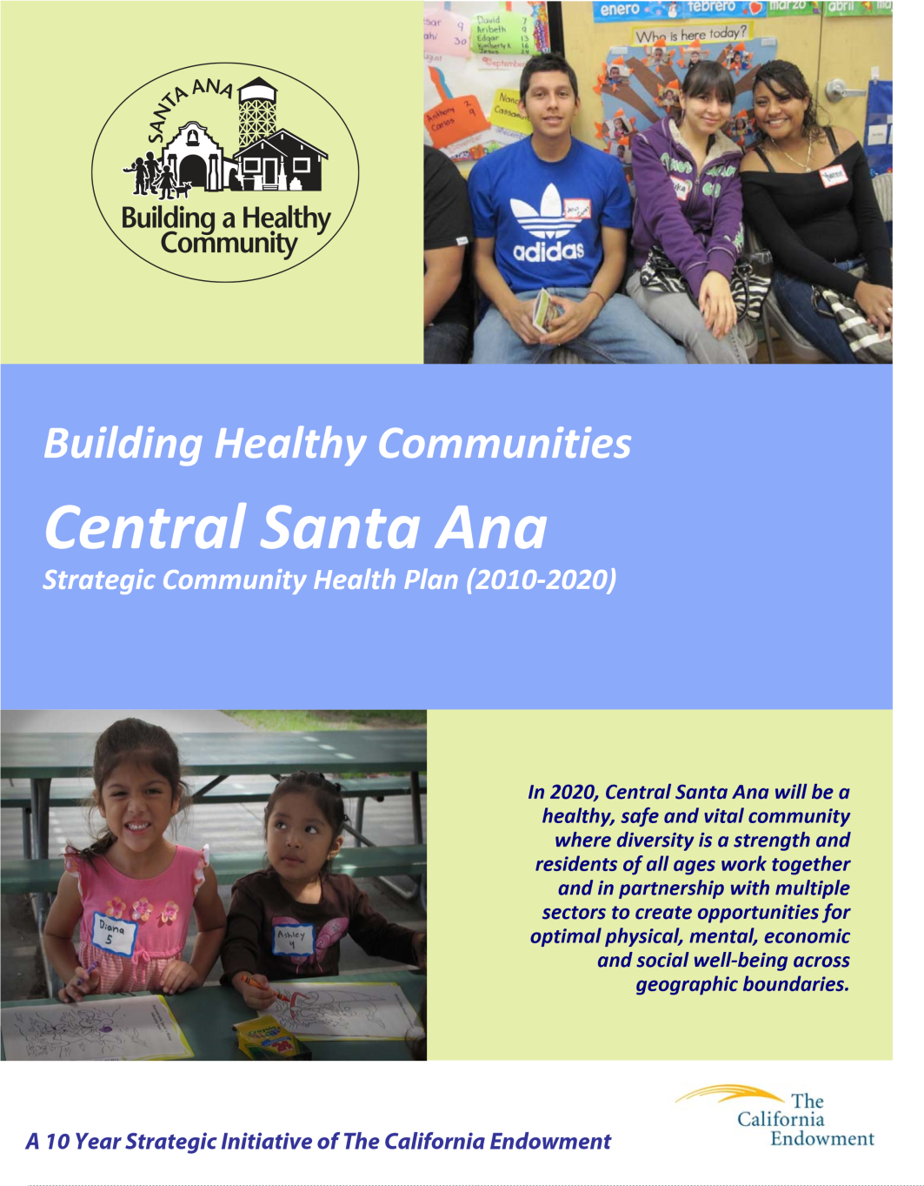
SABHC Objectives
Overall Change Outcomes
Community empowerment
Integrated services and systems
Health promoting land use and planning.
Community safety
Youth development
Economic empowerment
Immigration Reform

Slide 4
SABHC Objectives
Community Empowerment
Integrated Systems and Services
Residents have knowledge of how and where decisions are made in Santa Ana
Community development and reinvestment is accountable to community members
Increase civic participation and involvement in decision making of all Santa Ana residents
Create an independent structure
Increase access to culturally competent healthcare that includes physical and mental health
Integrate existing and new physical and mental health programs
Health Promoting Land Use
Add more safe open space
Increase the availability of healthy food options in the community
Increase the stock of quality Affordable Housing

Slide 5
SABHC Objectives
Community Safety
Healthy Youth Development
Reduce the activity and violence related to gangs and drugs
Improve the relationship between the community and police department
Reduce violence in Santa Ana homes
Undocumented community members are protected from ICE
Improve students’ academic achievement
Support all students graduating from high school on time
Ensure that all students have improved opportunities to develop a career or pursue college-education

Slide 6
SABHC Objectives
Economic Empowerment
Immigration Reform
Lower income residents have access to quality, affordable housing
Residents have access to good jobs with benefits
Residents have access to a full range of financial services and are financially literate
Residents have knowledge of the rights and protections
The institution of “sanctuary” policies that eliminate or limit cooperation between the city (especially police) in Santa Ana and Immigration and Customs Enforcement
Organized and consistent advocacy for immigration reform
All Santa Ana students have improved opportunities to practice a career or pursue college‐education

Slide 7
Participants
Steering Committee Members
Grantee Organizations
Isabel Becerra, Org
Gloria Alvarado, Org
Cesar Covarrubias, Org
Adriana Moreno, Org
Sophia Chhoen, Org
Barbara Kidder Garcia, Org Alt
Bao Nguyen, Org Alt
Laura Kanter, Org Alt
America Bracho, Org Alt
Yenni Diaz, Org Alt
Silvia Acevedo, Adult
Adolfo Sierra, Adult
Araceli Robles, Adult
Abel Ruiz, Adult
Ly Heang Trang, Adult
Ana Lidia Tutila, Adult Alt
Adriana Sanchez, Adult Alt
Ramona Alvarez, Adult Alt
Tixoc Ventura, Adult Alt
Zulyema Valera, Youth
Miriam Lopez, Youth
Ignacio Rios, Youth
Lily Tang, Youth
Carlos Perea, Youth
Sandibel Ramirez, Youth Alt
Ramon Campos, Youth Alt
Victoria Perez, Youth Alt
Hilda Ortiz, Youth Alt
Dulce Saavedra Youth Alt
CHIOC
LHA
OCLF
KidWorks
El Centro
Kennedy Commission
PLC
OCCORD
Madison Park
The Center OC
ACLU
The Coalition of Community Clinics
OCCCO
BMOC
RAIZ
CLUE
The Cambodian Family
Santa Ana College
Voice of OC
Notes:
The “Community”:
Adults and youth involved in policy campaigns
Previous steering committee members
Previous planning phase participants
Systems leaders

Slide 8
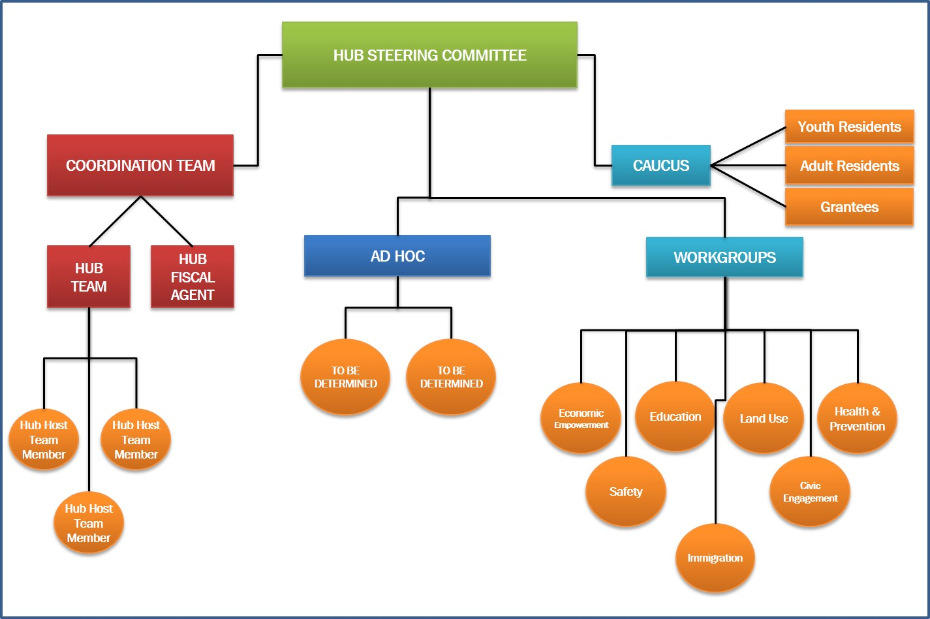
SABHC Structure
Notes:
Purpose:
Drive and lead the work of the collaborative to better the environment, public policies, and outcome for children, youth and their families in Central Santa Ana.
Authority:
Final decision makers on behalf of the SABHC collaborative regarding.

Slide 9
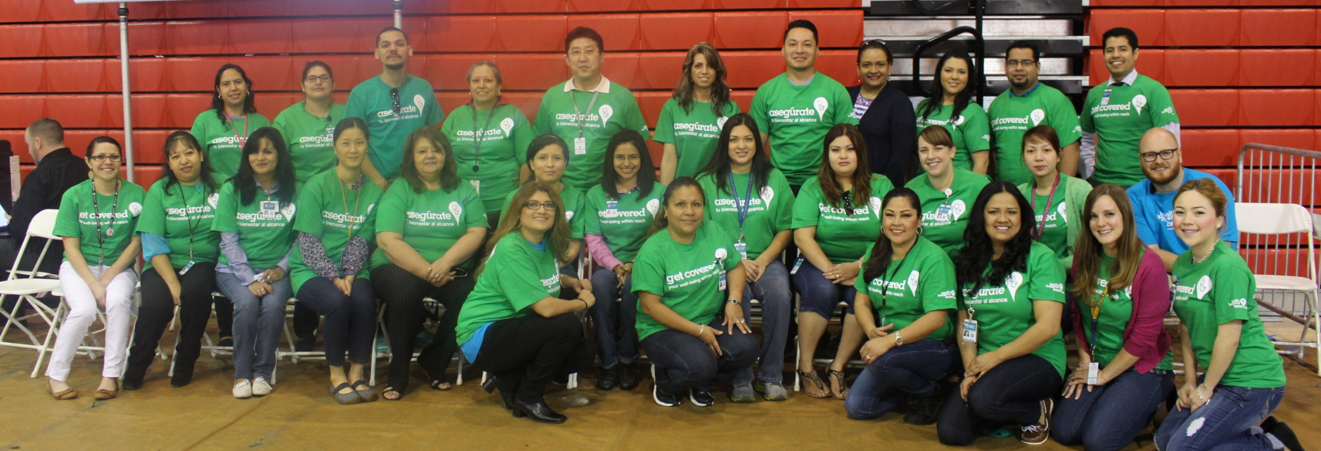
PREVENTION/PREVENCION
Affordable Care Act (ACA) Outreach and Enrollment- a multifaceted approach to outreach and enrollment for families with need. A door-to-door effort to visit over 200,000 homes in Santa Ana, Anaheim, Garden Grove, Westminster, and other parts of the county, education and enrollment events, a new information and referral website (www.coveredoc.org) with current information and referrals services on the Affordable Care Act, enrollment at Community Health Centers throughout Orange County, and a toll free phone number for OC residents with information and referrals in English and Spanish.

Slide 10
Economic Development, Land Use, Civic Engagement
Strategic Plan
Circulation Element/General Plan (BikeIt! Santa Ana, Housing/code enforcement)
Demand Study- City Owned Properties
EDUCATION
Local Control Funding— In 2013, the state approved a new system for funding public education with the goal that every child in public school is prepared to succeed in college and in the workforce. Our local coalition is working with SAUSD to support the implementation of local control funding to improve school climate and student success in SAUSD.
Restorative Justice – a citywide campaign in Santa Ana committed to keeping our schools safe, our streets safe and our youth out of the juvenile justice system through the implementation of restorative justice. Restorative justice brings people together to repair harm, gives attention to community safety, victim’s needs and offender accountability and growth.

Slide 11
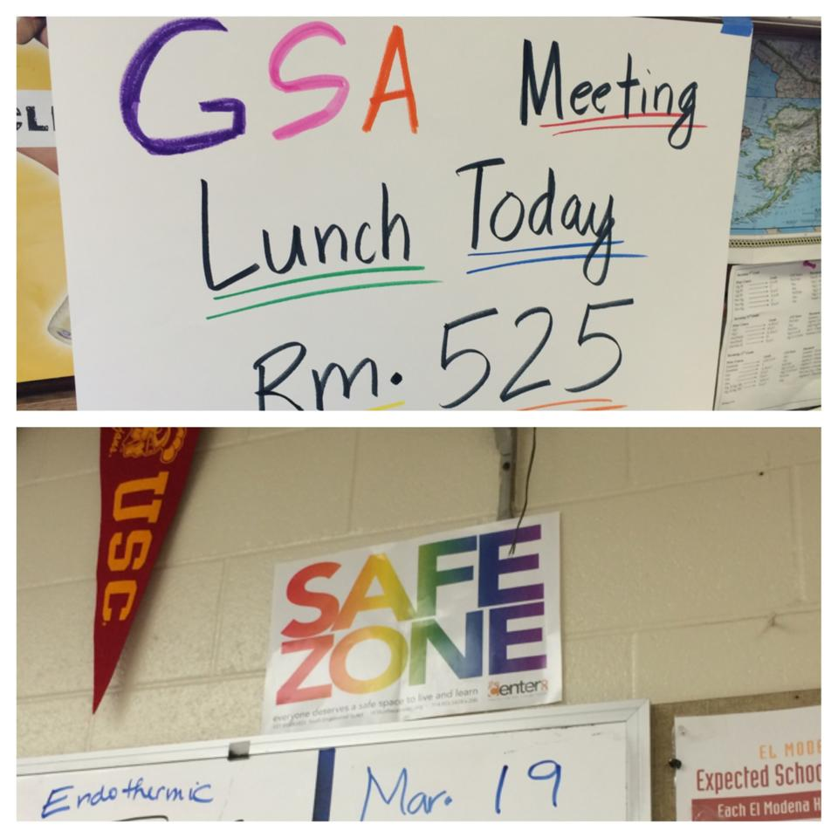
SAFETY, IMMIGRATION and Additional Campaigns
Keep Our Families Together:
Stopping deportations
Ending the school to deportation pipeline (sharing of information)
Ending collaboration between City police and ICE
Color Me Equal
Whoa, Slow, Go!
Santa Ana Composts!
Wellness Corridor

Slide 12
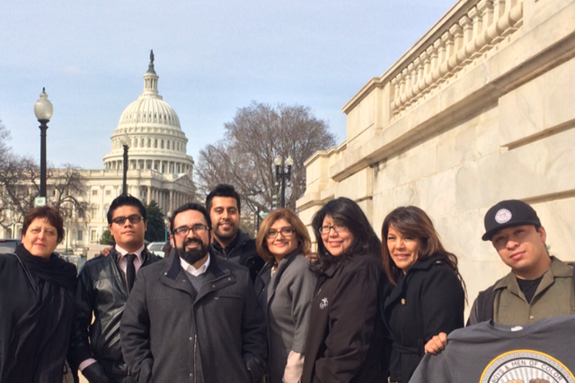
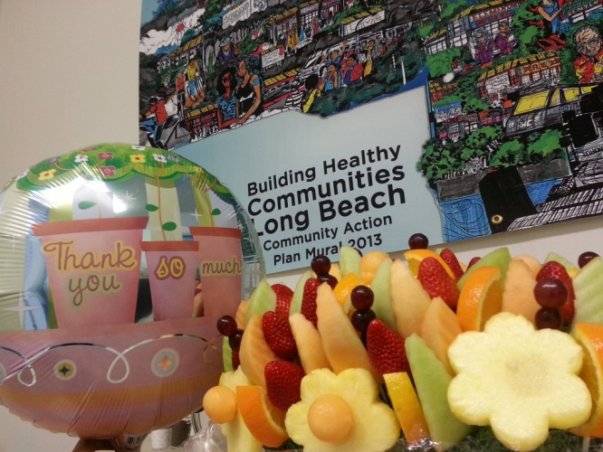
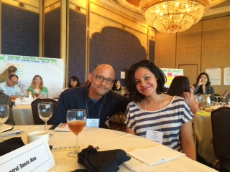
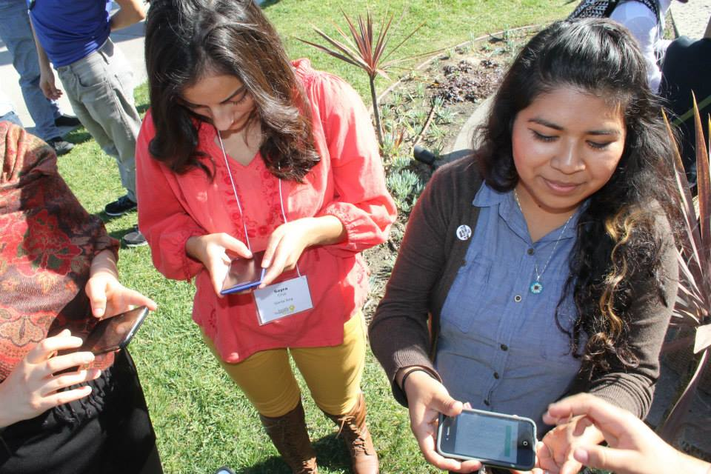
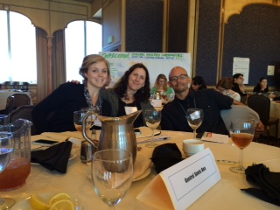

Slide 13
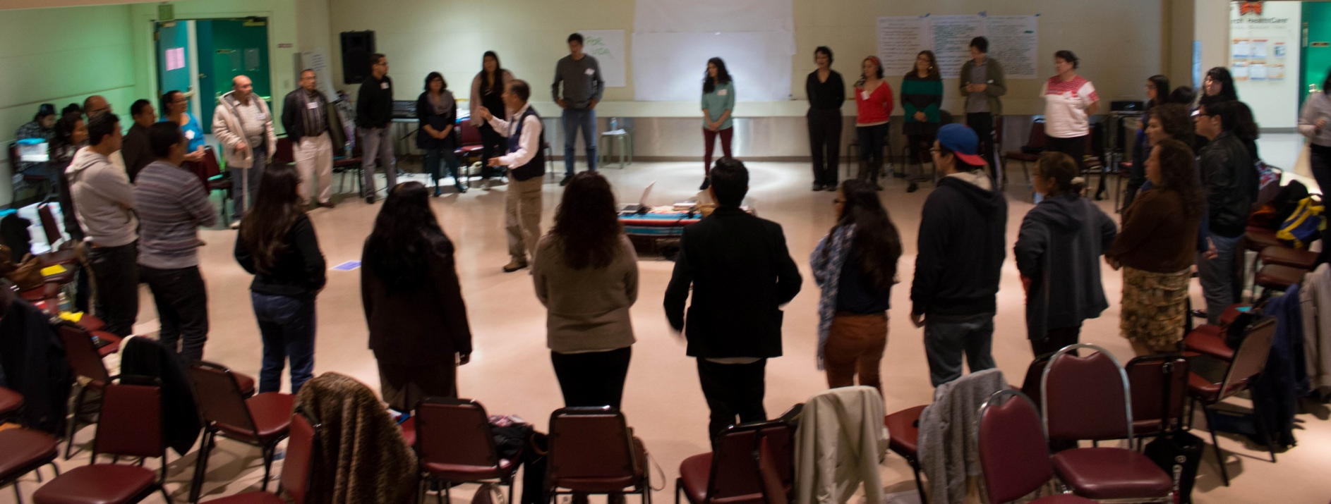
Our Accomplishments
DUI policy change
Community Access Agreement Roosevelt
Peace marches
Sunshine Ordinance
Joint Use Madison
Santa Ana Strategic Plan
New commissioners
Restorative Justice Inclusion in LCAP

Slide 14
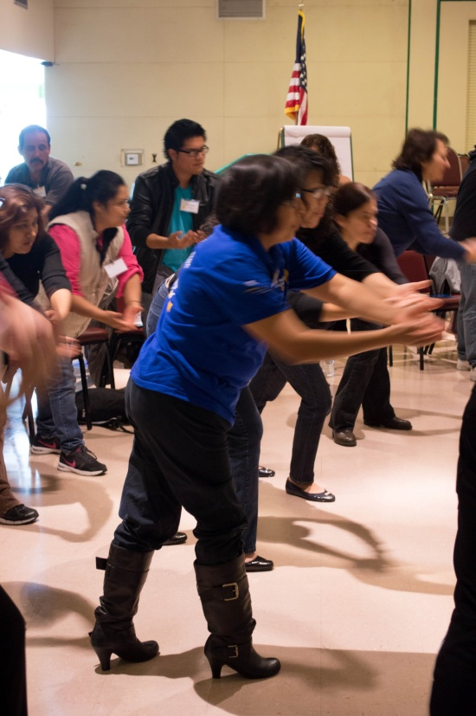
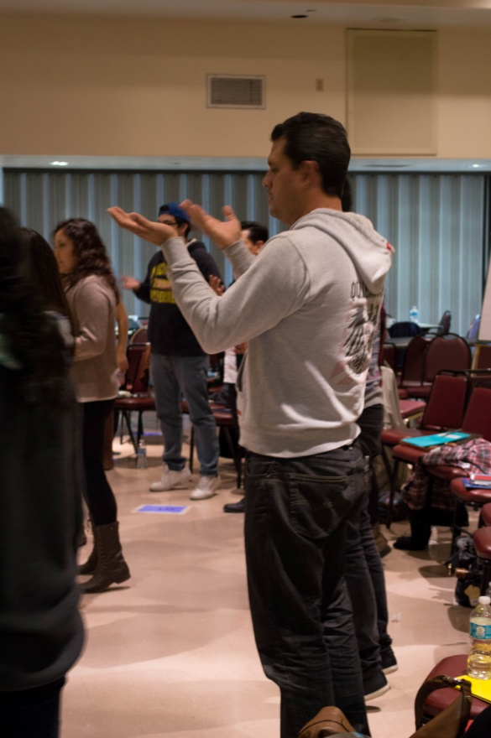
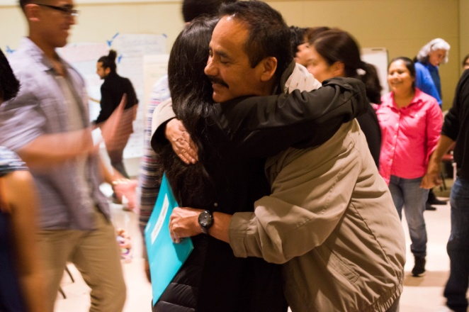
Creating the Culture of our Movement
Policy Change + Leadership Development + Personal and Collective Transformation

